Slide 1
Chapter 3: Testing in Software Life Cycle
Software Testing
General Levels of Testing

Slide 2
Agenda for today
Levels of Testing
Component Testing
Stub’s and Drivers
Unit Testing
Points for Unit Testing
Tools for Unit Testing
Integration Testing
Integration Testing Approaches
Bottom Up and Top Down integration Testing
BigBang and Adhoc integration Testing

Slide 3
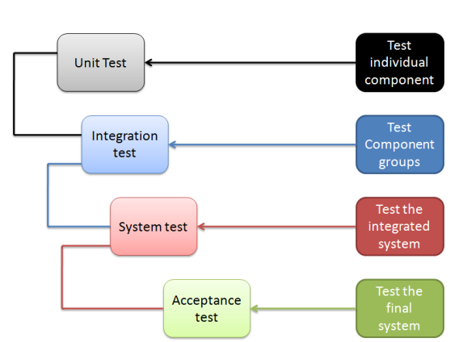
Levels of Testing

Slide 4
Component Testing
Testing of separate software component is known as component testing
Objective of component testing is to verify the input/output behavior of the test object
A group of components is known as module testing.
The main characteristic is that the software components are tested individually and isolated from all other software components of the system.
The isolation is necessary to prevent external influences on components.
Most often stubs and drivers are used to replace the missing software and simulate the interface between the software components

Slide 5
Test Objects, Stubs and Driver
Test objects are program modules/units or classes, (database) scripts, and other software components.
Drivers are the dummy programs which are used to call the functions of the lowest module in case the calling function does not exist.
OR
→ A driver calls the component to be tested.
Stubs can be referred to as code a snippet which accepts the inputs/requests from the top module and returns the results/ response.
OR
-> A stub is called from the software component to be tested.

Slide 6
Component Testing Objectives
Reducing risk
Verifying whether functional and non-functional behaviours of the component are as expected
Building confidence in the component’s quality
Finding defects in the component
Preventing defects from escaping to higher test levels

Slide 7
Component Testing: Example
Scenario: There are two web pages. In one of the web pages there are a many certain fields like username, address, mobile no. etc in which data has to be entered. In the other (second) web page also there are certain fields which carry forward the data from the first page. Testing the functionality of these individual pages is called Component Testing.
Components are tested as soon as they are created,
There can be results retrieved from a component under test, are dependent on other components which in turn are not developed
So in order to test that component, we use Stubs and Drivers

Slide 8
Stubs and Driver’s Difference
 | Stub | Driver
Type | Dummy codes | Dummy codes
Description | A piece of code that emulates the called function. | A piece of code that emulates a calling function.
Used in | Top Down Integration | Bottom Up Integration
Purpose | To allow testing of the upper levels of the code, when the lower levels of the code are not yet developed. | To allow testing of the lower levels of the code, when the upper levels of the code are not yet developed.

Slide 9
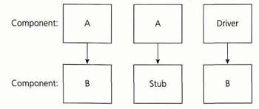
Stub and Driver Example 1:
Suppose Function A that calculates the total marks obtained by a student in a particular academic year.
Suppose this function derives its values from another function (Function b) which calculates the marks obtained in a particular subject.

Slide 10
Example 2
We have 3 modules login, home, and user module in website.
Login module is ready and need to test it, but we call functions from home and user (which is not ready)
What we will do?
Stub
For the same example if we have Home and User modules get ready and Login module is not ready.
Driver

Slide 11
Unit Testing
Check individual parts functionality
Aim is to isolate each unit of the system to identify, analyze and fix the defects
Done by developers
Reduces cost of testing
Developers can also re-use code
Facilitates changes
Example: Testing a function: whether the loop or program is working properly or not

Slide 12
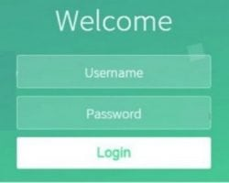
Unit Testing Example
Almost every web application requires its users/customers to log in. For that, every application has to have a “Login” page which has these elements:
- Account/Username
- Password
- Login/Sign in Button
- For unit testing what which test cases will be needed?

Slide 13
Points for Unit Testing
Functional :
- Does code functionally perform the task?
Boundaries :
- What are the minimum, maximum values for the function?
Termination:
- What happens in the normal termination and abnormal termination?
Outputs:
- What are the expected outputs of the function?
Inputs:
- What are the expected inputs to the function?
Interaction:
- What other modules/functions does this interact with?

Slide 14
Unit Testing Tools
Junit
Nunit
JMocKit
EMMA
PHPUnit

Slide 15
Integration Testing
Integration testing is carried out when integrating (i.e., combining):
Units or modules to form a component
Components to form a product
Products to form a system
Multiple modules & these are developed by different developers.
Find interface defects between the modules/functions
Checks connectivity or data transfers
Developer’s or tester’s performs this type of testing.
Example: Battery and sim card are integrated i.e. assembled in order to start the mobile phone.
e.g Computer and keyboard

Slide 16
Integration Testing Example
Online shopping website
One developer was assigned to develop each of the modules below.
User registration and Authentication/Login
Product Catalogue
Shopping Cart
Billing
Payment gateway integration
Shipping and Package Tracking
The QA Manager suggested that integration testing should be performed.
Which types of bugs found during integration Testing?

Slide 17
Integration Testing Approaches
Mainly four approaches:
Top Down approach
Bottom up approach
BigBang approach
Adhoc approach

Slide 18
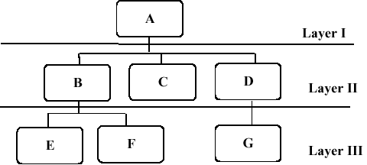
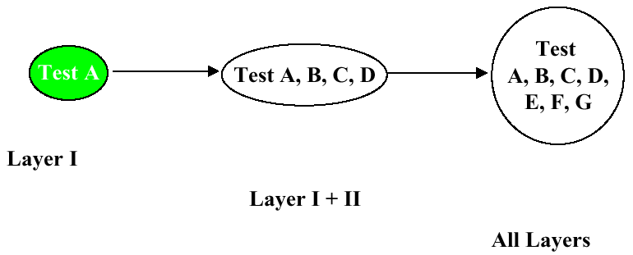
Top-down Integration Testing
Testing the top-most modules
Gradually moving down to the lowest set of modules one-by-one
Stubs used when lower modules are not ready
Critical Modules are tested on priority

Slide 19
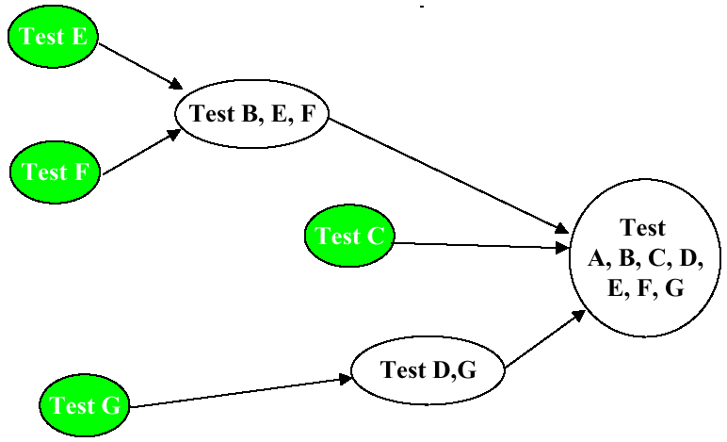
Bottom up Integration Testing
Starts with testing the lowest units of the application
Gradually moving up one-by-one.
Drivers will be used to simulate the functionality of the missing modules
Development and testing can be done together

Slide 20
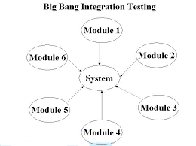
Big Bang Integration Testing
All components tested atleast once
Individual modules of the programs are not integrated until every thing is ready.
Convenient for small systems
Saves time

Slide 21
Ad hoc Integration Testing
Testing performed without proper planning and documentation
The components are being integrated in the (casual) order in which
they are finished.
Saves time because every component is integrated as early as possible into its environment.
Used for limited time to do exhaustive testing

Slide 22
Thank you

